Slide 1
lifeStories

Slide 2
lifeStories A lifeStory is a big-deal experience that reveslas, changes or affirms your understanding of you, your connections to the world around you and…LIFE!

Slide 3
lifeStories A lifeStory is a big-deal experience that reveals, changes or affirms your understanding of you, your connections to the world around you and…LIFE!
Title at least 5 of your lifeStories
and place them on your timeline.

Slide 4
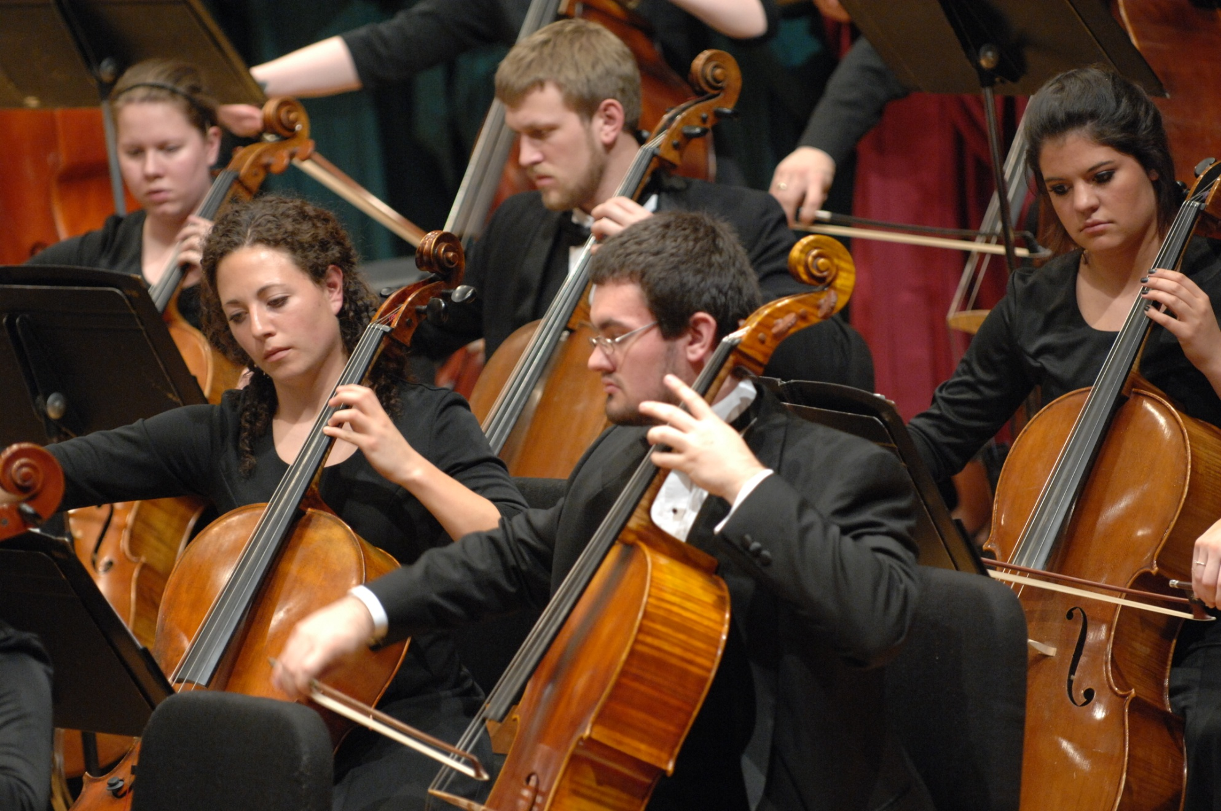
1. Get together with a partner. 2. One person tells a lifeStory. 3. The listener…listens. 4. Trade roles.

Slide 5
lifeStory The big picture (or…lifeStory has to do with your whole life, too!)
Discerning Talent and Skill

Slide 6
lifeStory The sense of the whole of a life in terms of its trajectory, its meaning, its core/heart…

Slide 7
lifeStory The sense of the whole of a life in terms of its trajectory, its meaning, its core/heart…
Reflect with a partner:
What overall themes or
questions relate to the
whole of your life thus far ?

Slide 8
But what does this have to do with vocation?

Slide 9
Wait a second— what is vocation?

Slide 10
Who Am I?
(talents, skills, aspirations, values, beliefs, passions, relationships, etc.)
A Wilder-influenced Reflective Model of Vocation
(Jon Leiseth, Vocation Associate, Concordia College, Moorhead, MN)

Slide 11
What are the authentic needs of my communities?
A Wilder-influenced Reflective Model of Vocation
(Jon Leiseth, Vocation Associate, Concordia College, Moorhead, MN)

Slide 12
What is really important?
A Wilder-influenced Reflective Model of Vocation
(Jon Leiseth, Vocation Associate, Concordia College, Moorhead, MN)

Slide 13
Who Am I?
What is really important?
What are the authentic needs of my communities?
A Wilder-influenced Reflective Model of Vocation
(Jon Leiseth, Vocation Associate, Concordia College, Moorhead, MN)

Slide 14
Who Am I?
What is really important?
What are the authentic needs of my communities?
How do I reflect and discern?
(how/when these things relate to one another--VOCATION!)
A Wilder-influenced Reflective Model of Vocation
(Jon Leiseth, Vocation Associate, Concordia College, Moorhead, MN)

Slide 15
lifeStory The sense of the whole of a life in terms of its trajectory, its meaning, its core/heart…
Reflect with the group:
What does your lifeStory reveal
about you, your communities
or what you see as really
important?

Slide 16
lifeStories

